Slide 1










Key
 | Birds
 | Plants
 | Mammals
 | Fish
 | Invertebrates
 | Benthos
 | Plankton
Birds
Plants
Fish
Mammals
Invertebrates
Benthos
Plankton
 | Birds |  | Invertebrates
 | Plants |  | Benthos
 | Mammals |  | Plankton
 | Fish
Terrestrial
Marine
Freshwater
Terrestrial
Marine
Freshwater
Notes:
Bird – created by parkjisun
Tree – created by Delwar Hossain,
Deer – created by Francisca Arévalo
Fish – created by Iconic
Butterfly – created by Jacqueline Fernandes
Shell – created by B Barrett Noun project
Bacteria – created by Boris Belov
Mountains by alice noir, ocean by alex muravev, lake by By Anton Gajdosik

Slide 2
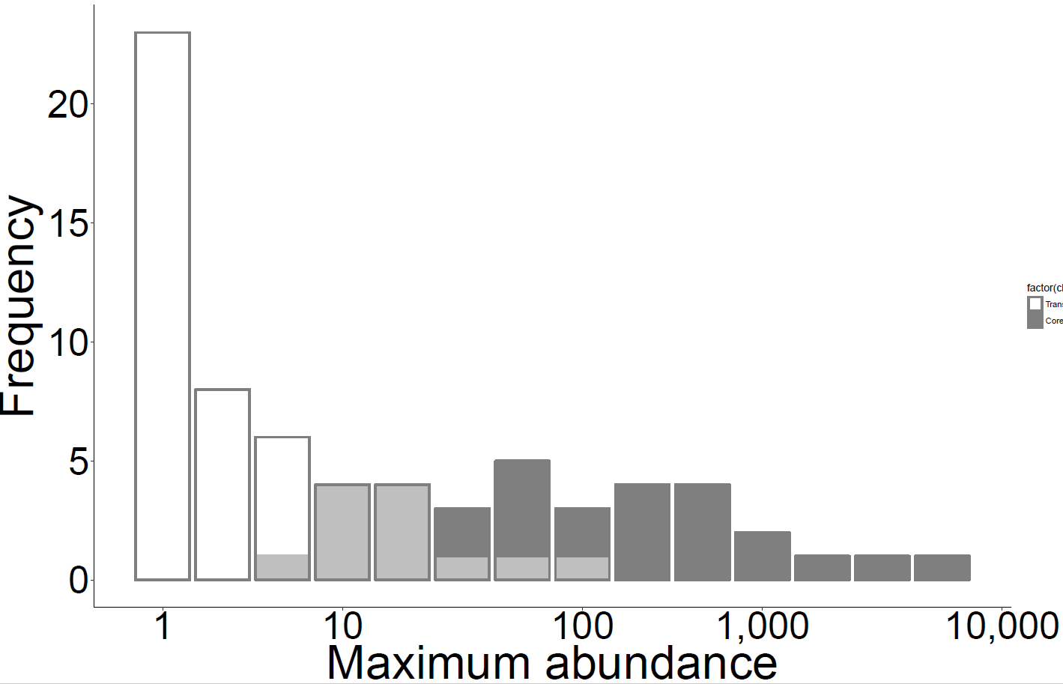
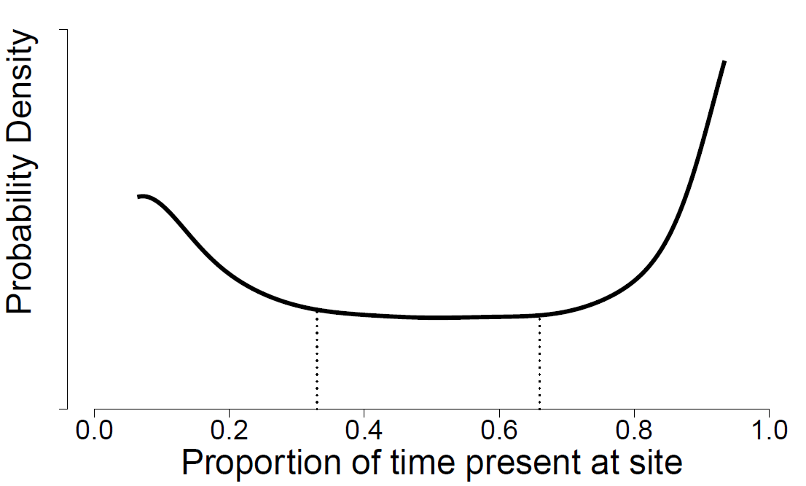
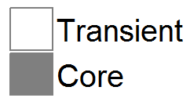
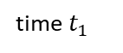
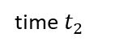
A
B
Transient
Core
C
D
All species
log(Species)
Excluding transients
log(area)
E
All species:
= 50%
Excluding
transients:
0
= 0%
time $t_{1}$
time $t_{2}$
Turnover
Notes:
Figure 1

Slide 3
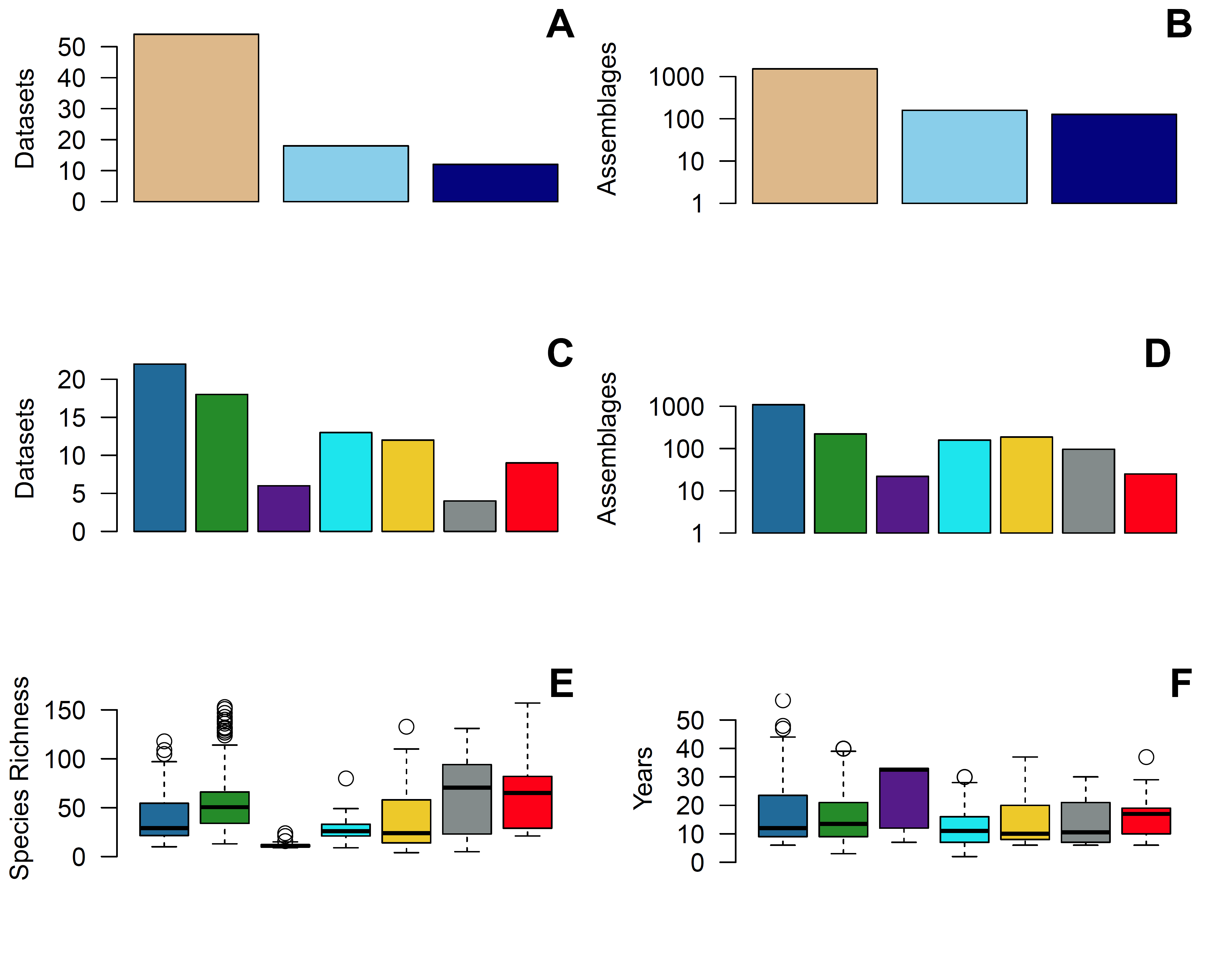
Birds
Invertebrates
Terrestrial
Benthos
Marine
Plants
Freshwater
Fish
Plankton
Mammals
Notes:
Fig 1a-1f

Slide 4
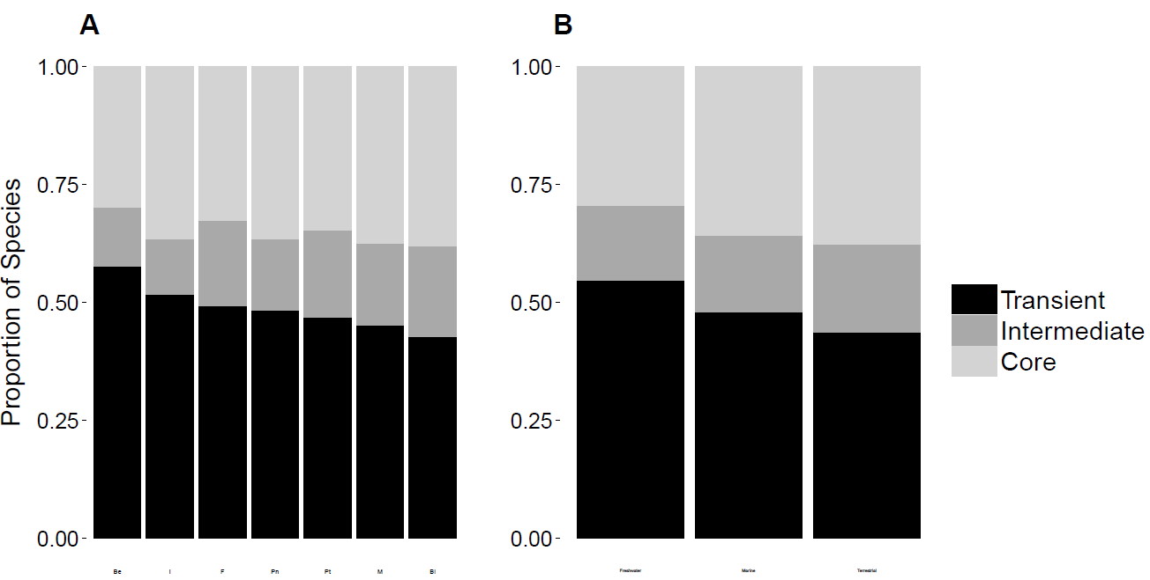




Fig 3a-3b
Notes:
FIXED

Slide 5
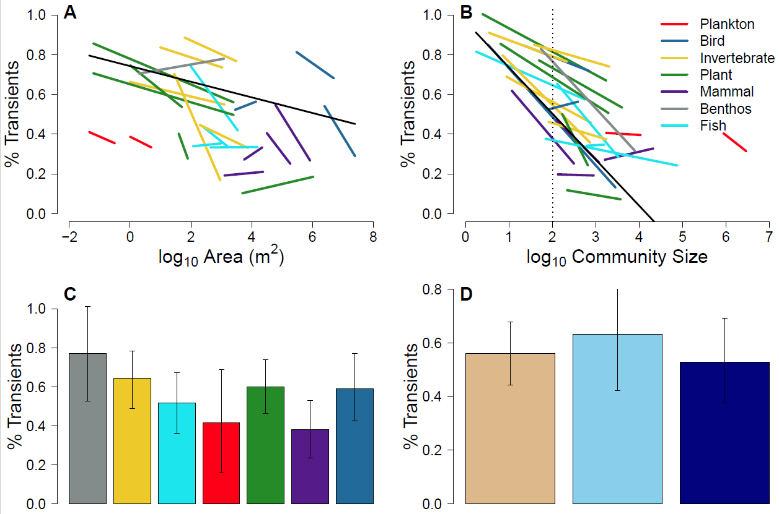

Fig 3a-3c
Simple R² = 0.44
Marginal R² = 0.12
Simple R² = 0.29
Marginal R² = 0.01

Slide 6
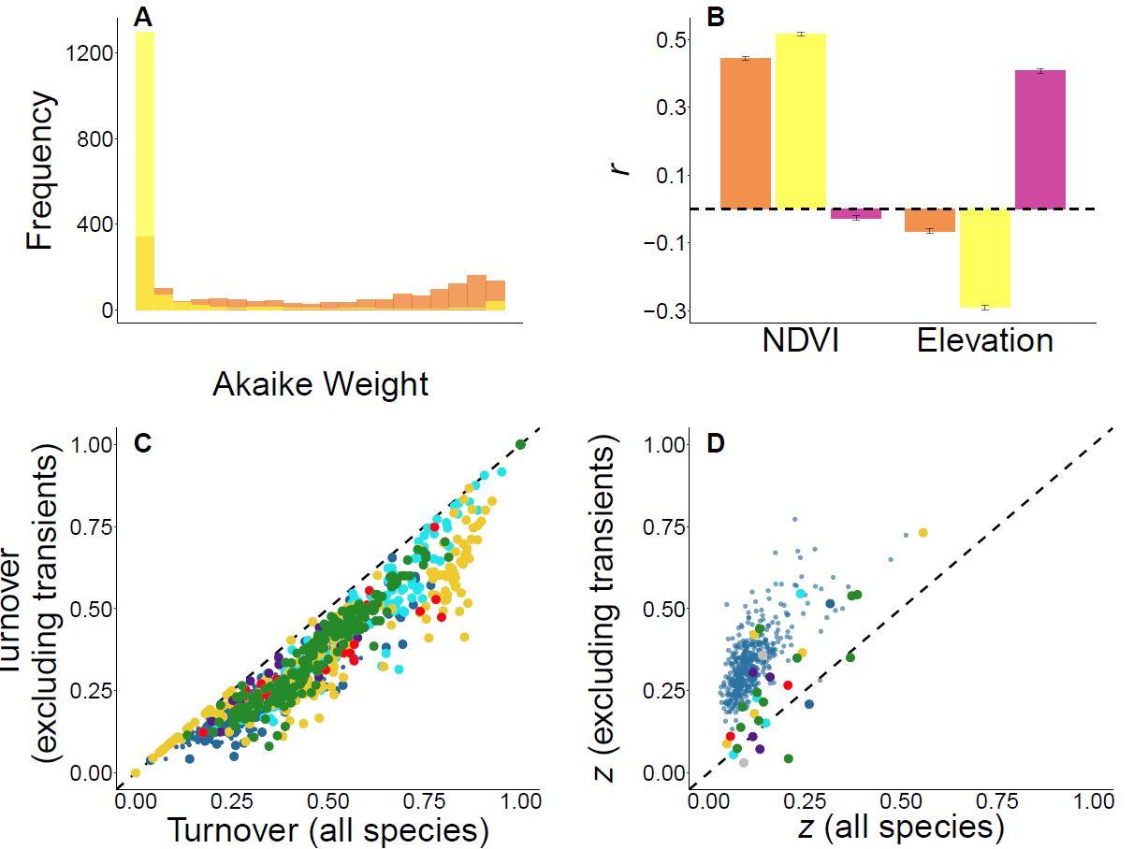


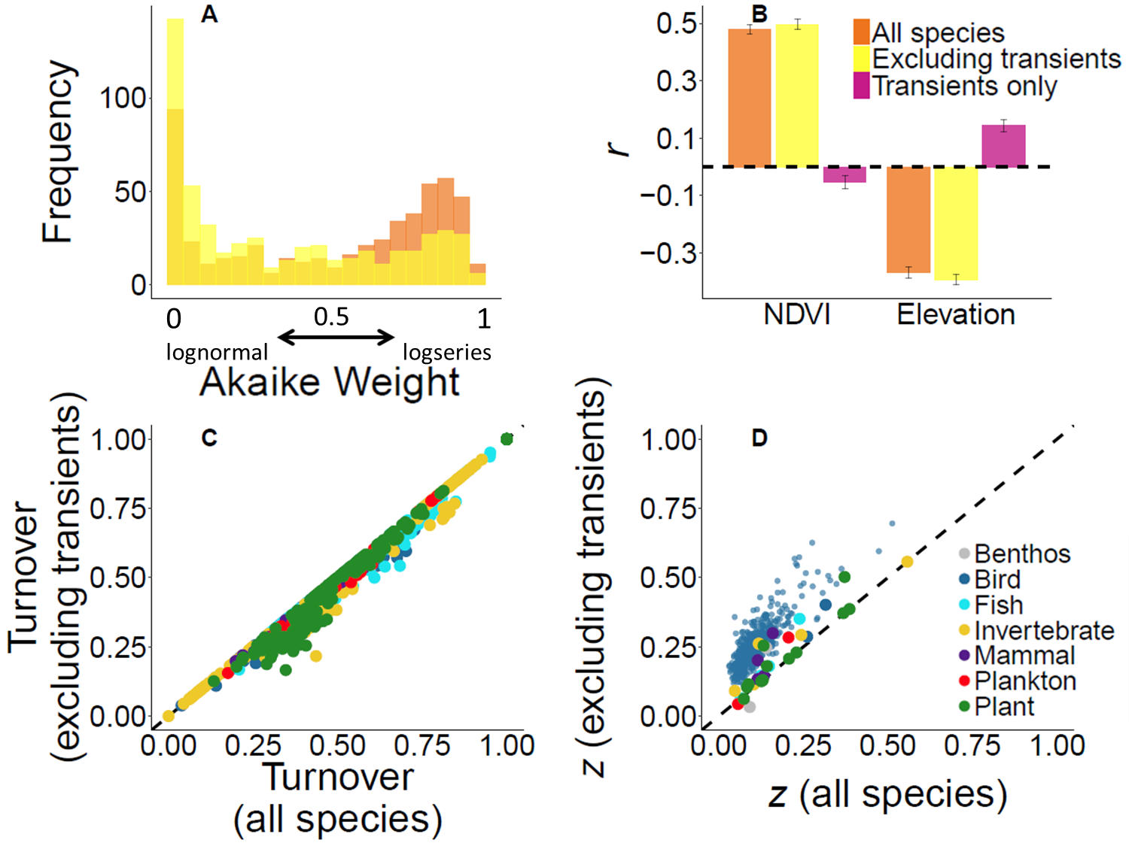
0
lognormal
0.5
1
logseries

Slide 7
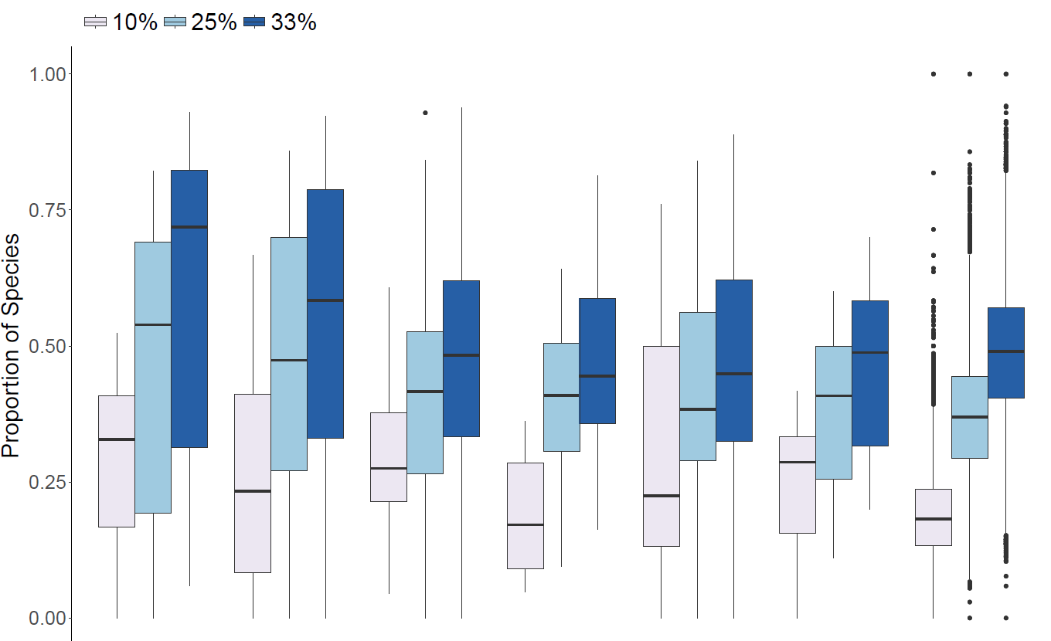

Slide 8
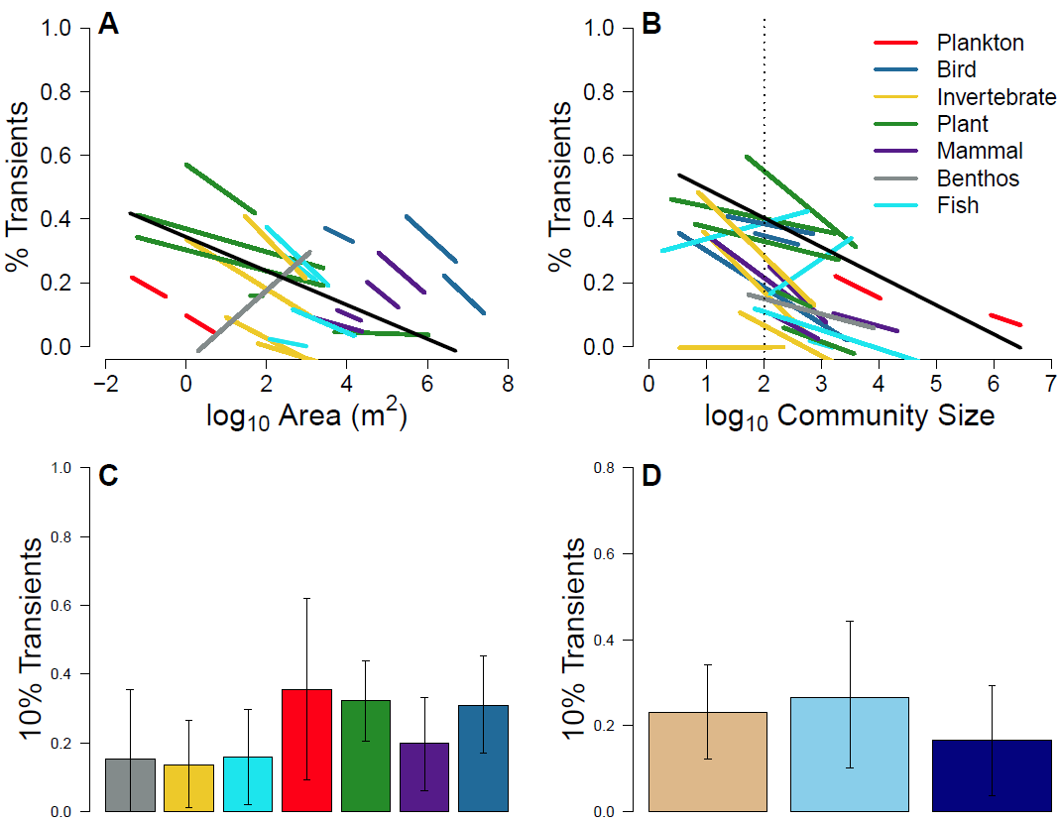


Supp10
Simple R² = 0.19
Marginal R² = 0.05
Simple R² = 0.21
Marginal R² = 0.06

Slide 9
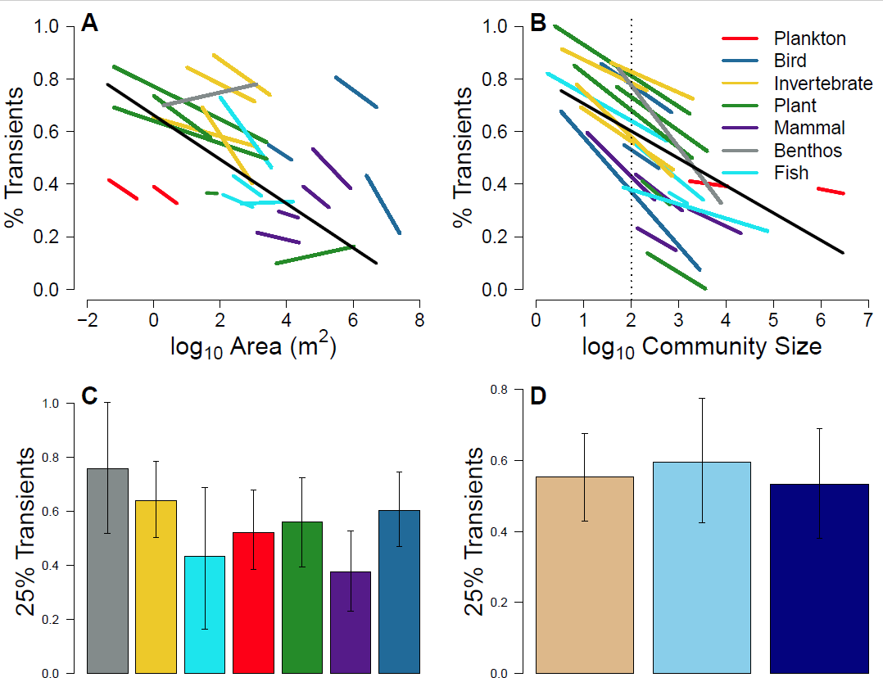

Supp 25
Simple R² = 0.33
Marginal R² = 0.11
Simple R² = 0.48
Marginal R² = 0.02

Slide 10
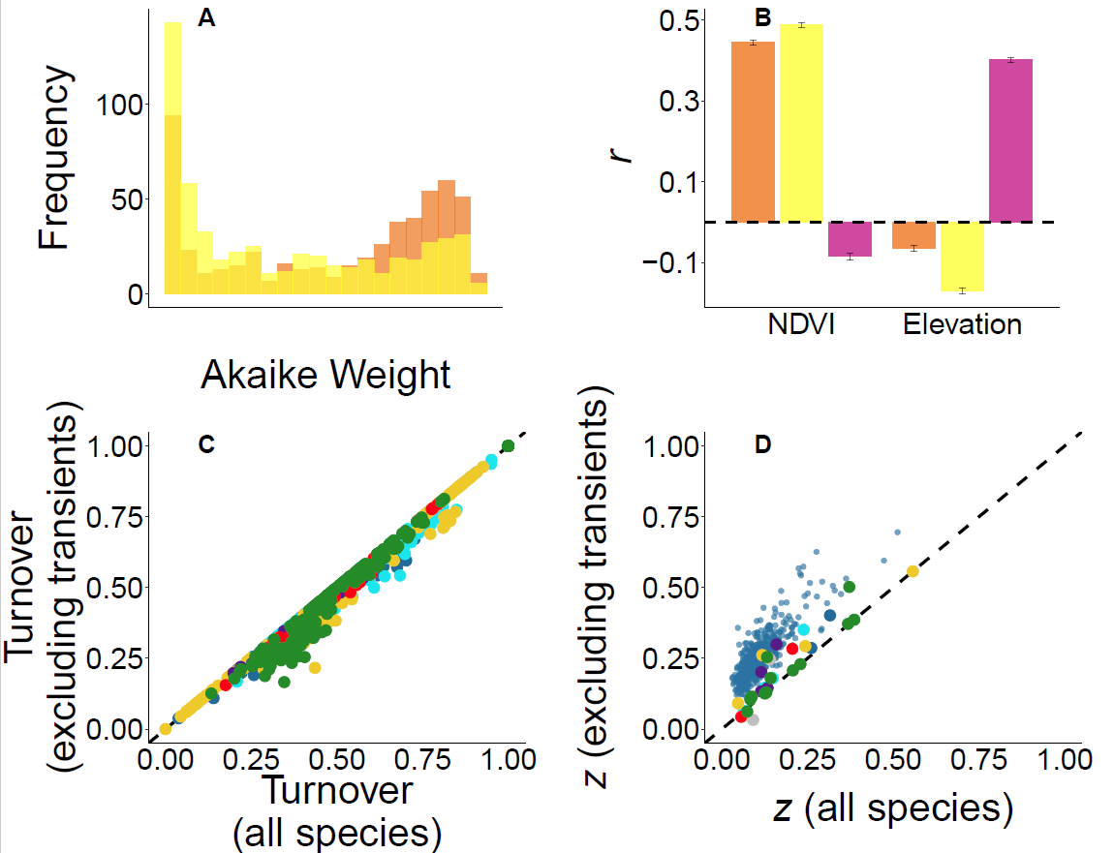
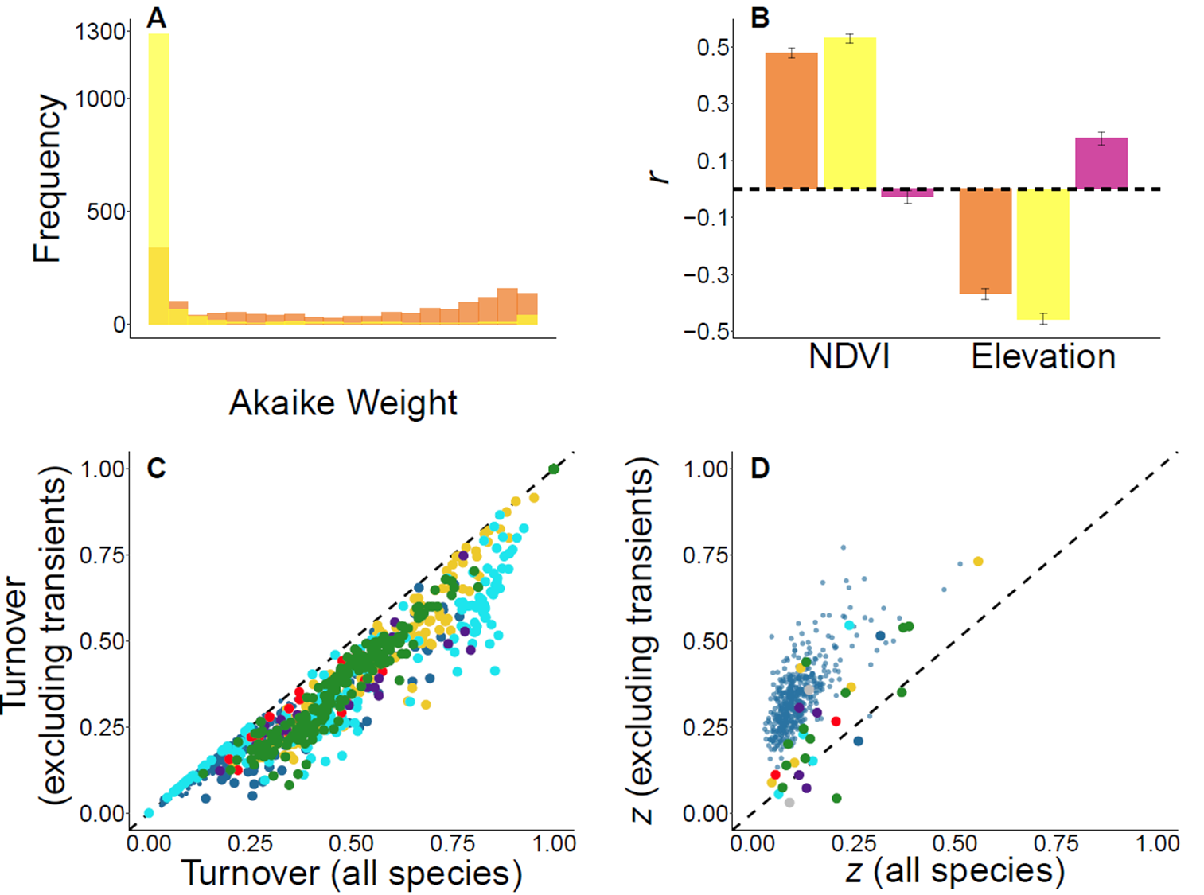
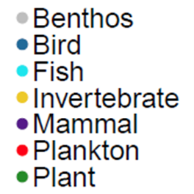
Supp 10
0
lognormal
0.5
1
logseries

Slide 11
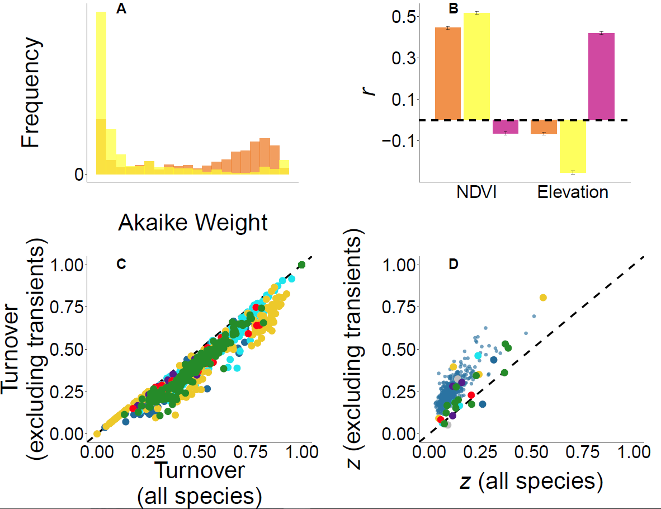

Supp 25
0
lognormal
0.5
1
logseries

Slide 12
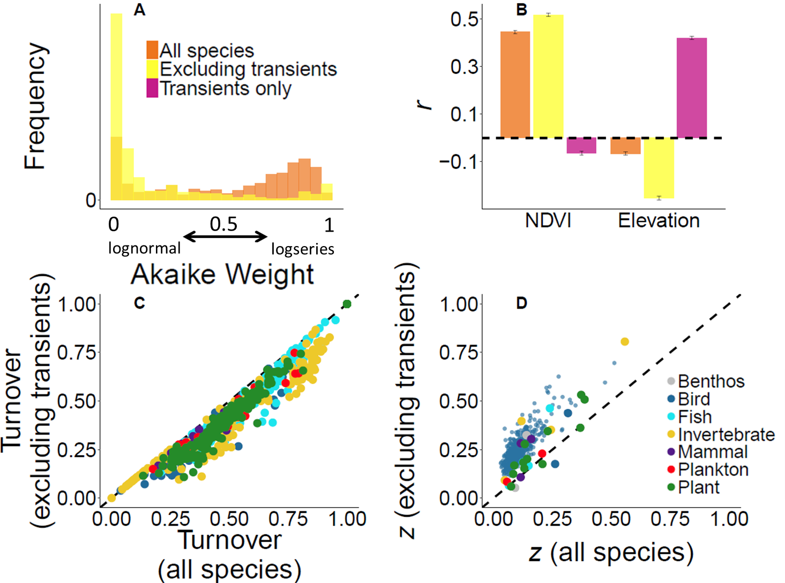
Supp 25
0
lognormal
0.5
1
logseries

Slide 13
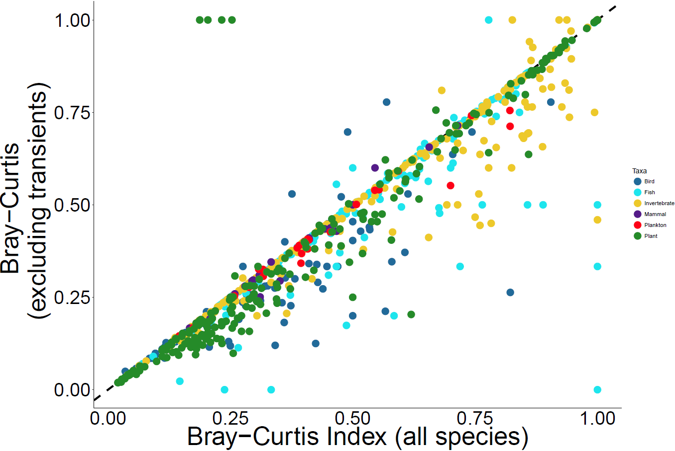

Slide 14
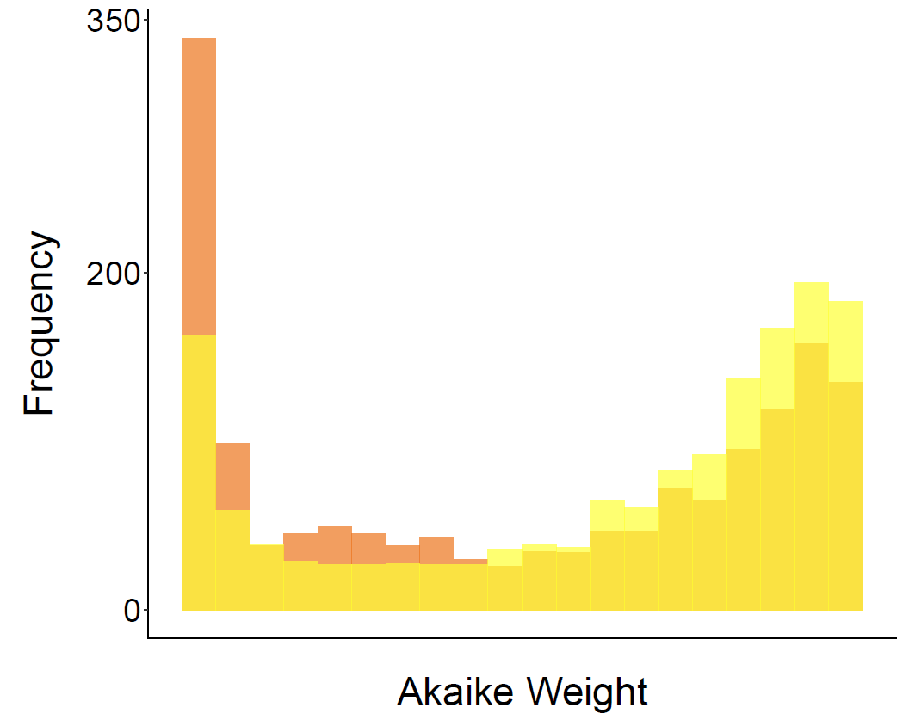
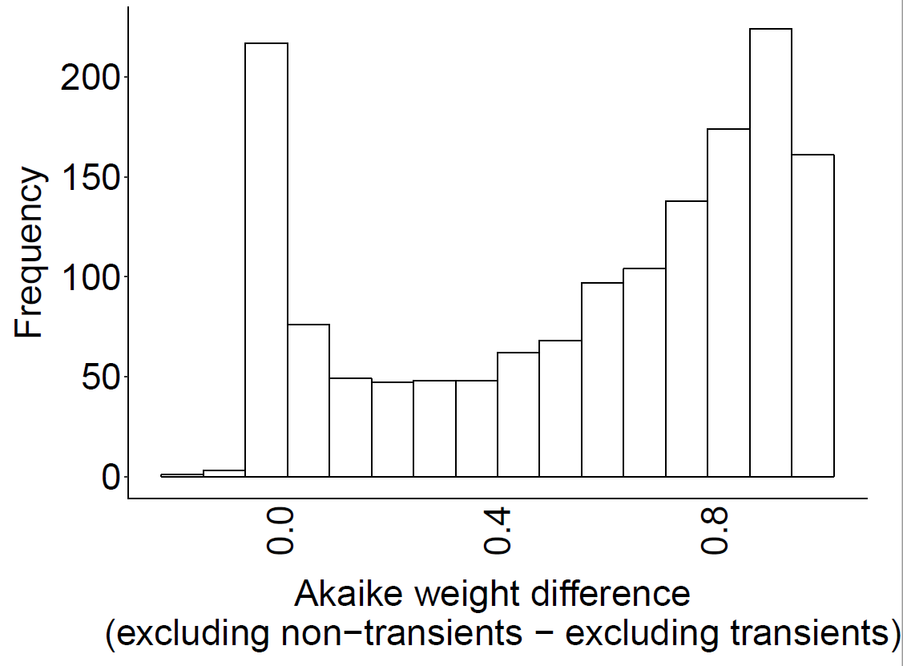
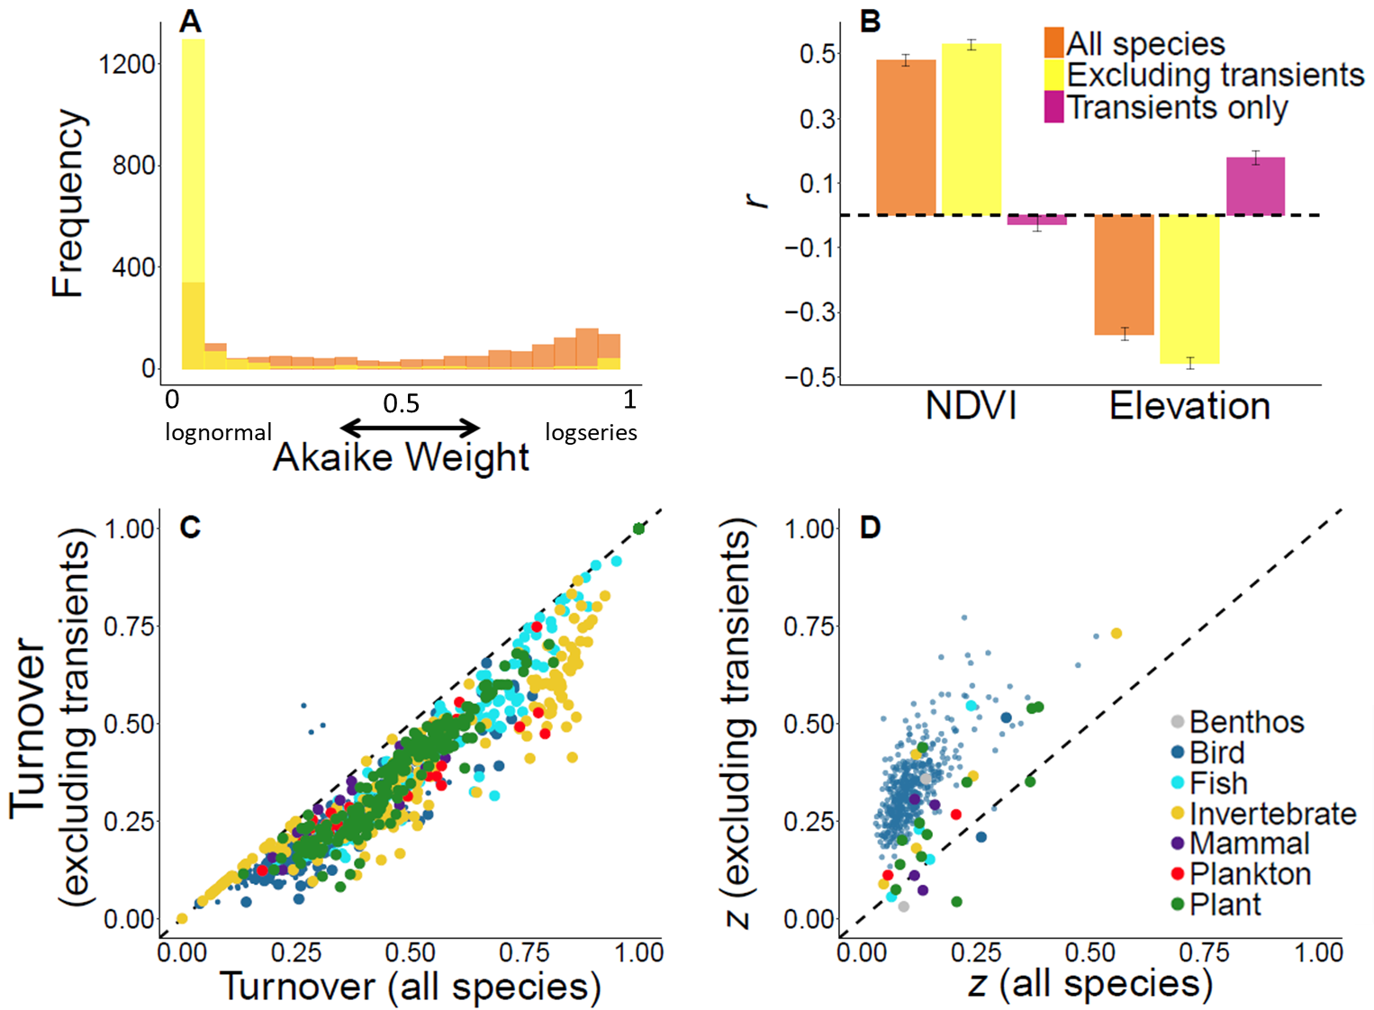
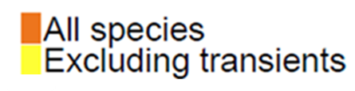
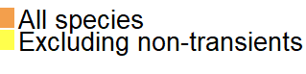
1a null
A
B
C
Frequency
Frequency
0
lognormal
1
logseries
0.5
Akaike Weight

Slide 15
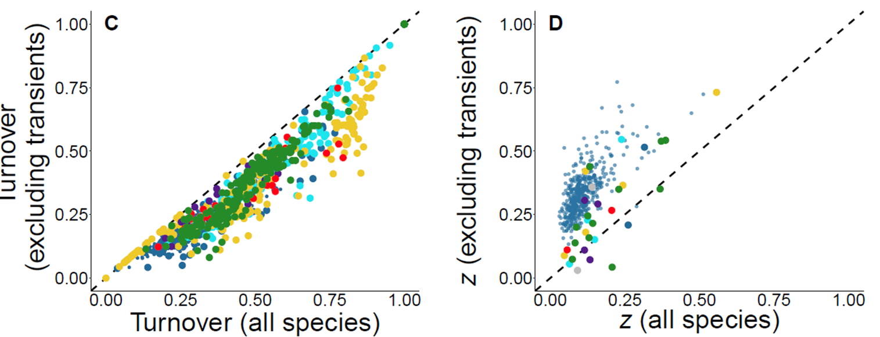
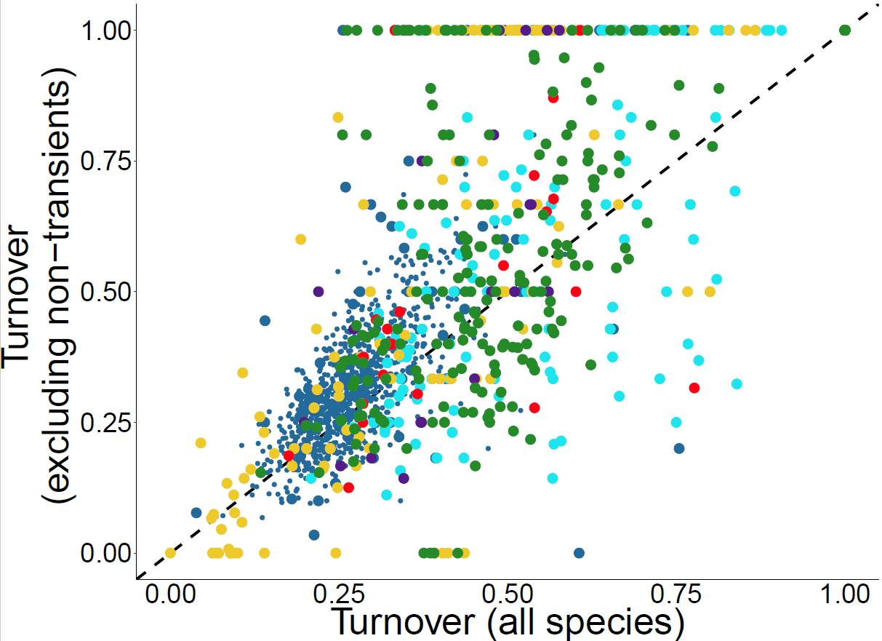
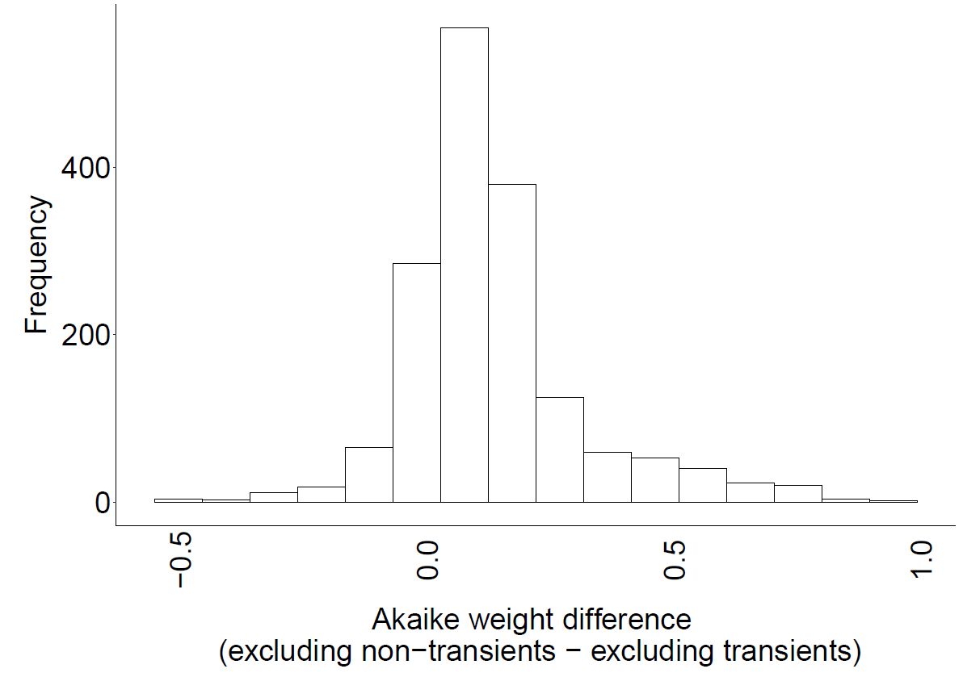
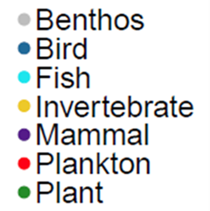
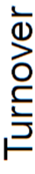
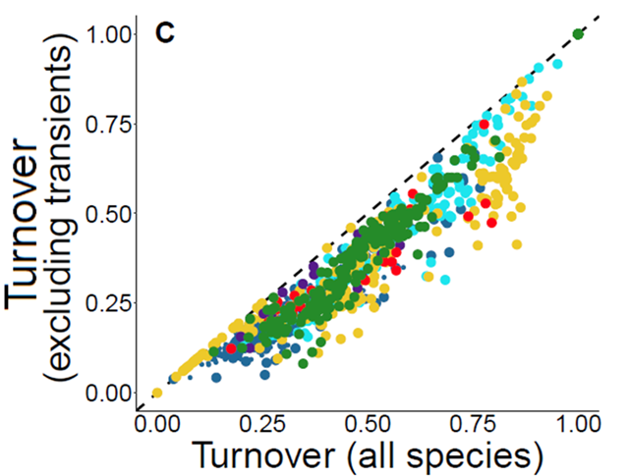
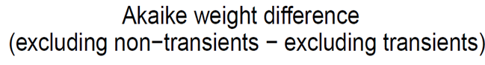
Null turnover
A
B
C
Frequency

Slide 16
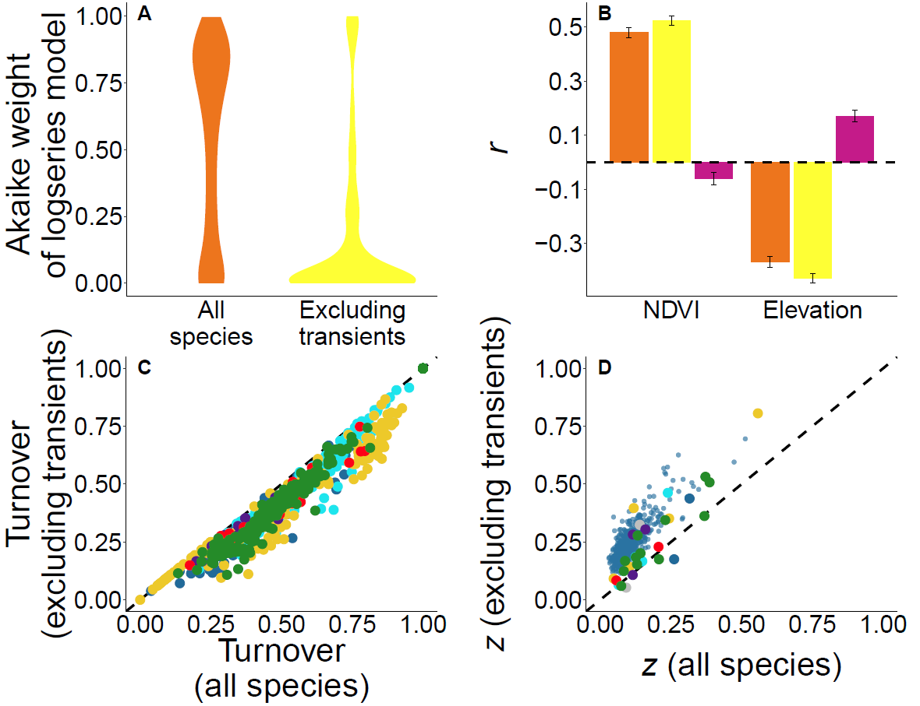
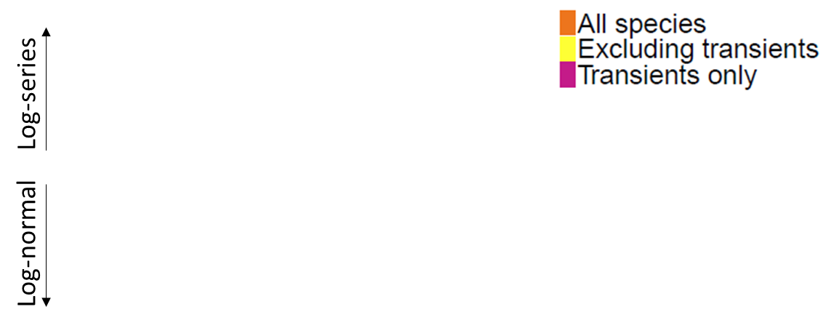


Slide 17
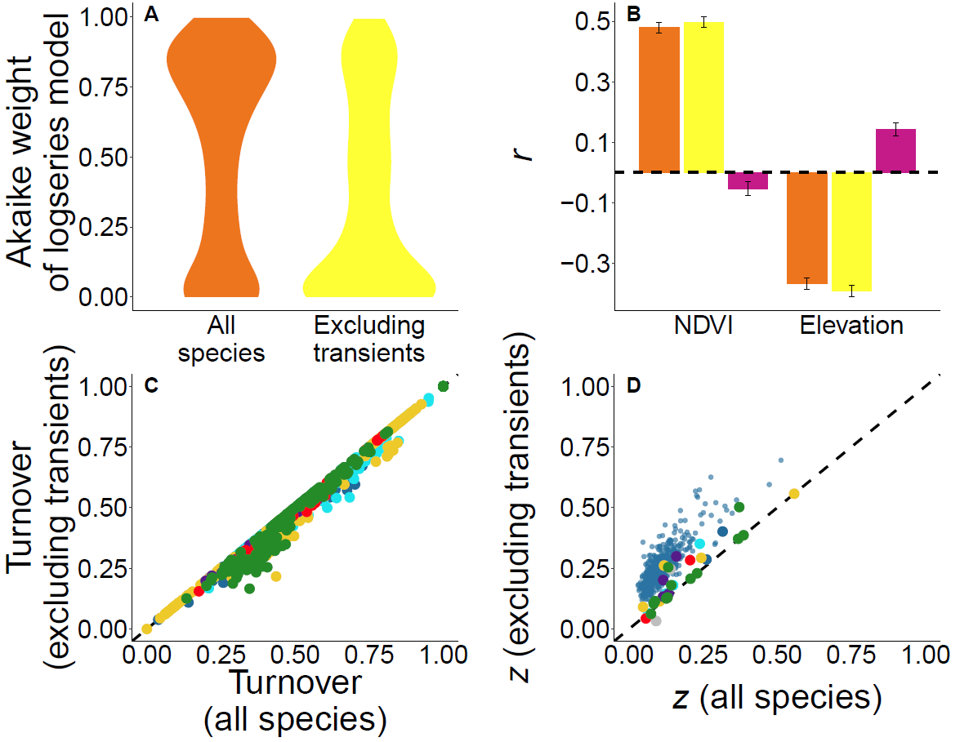
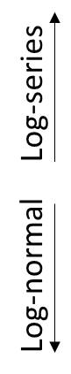

Slide 18







Species temporal occupancy strongly determined by environment
Species temporal occupancy strongly determined by competition

